Slide 1
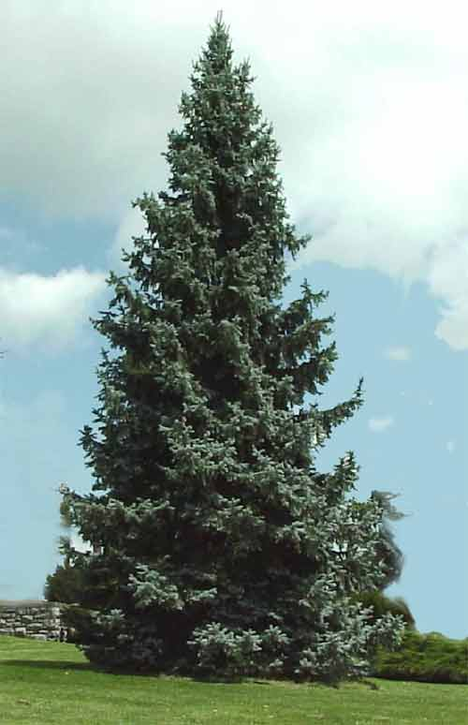
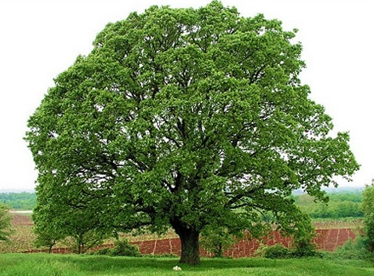
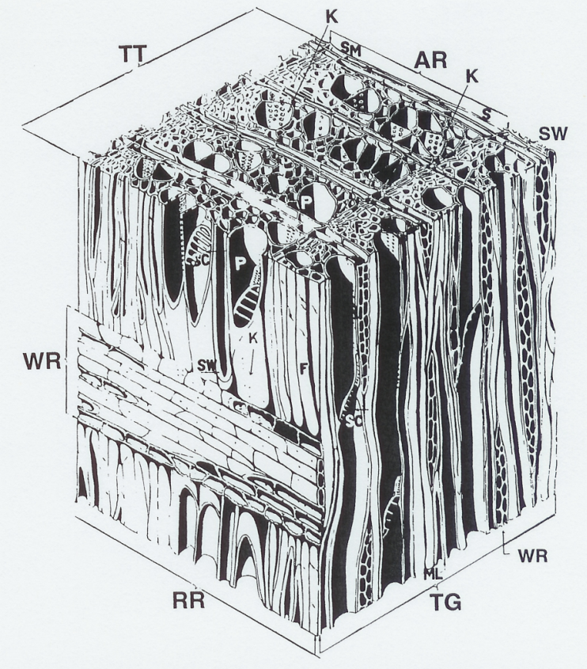
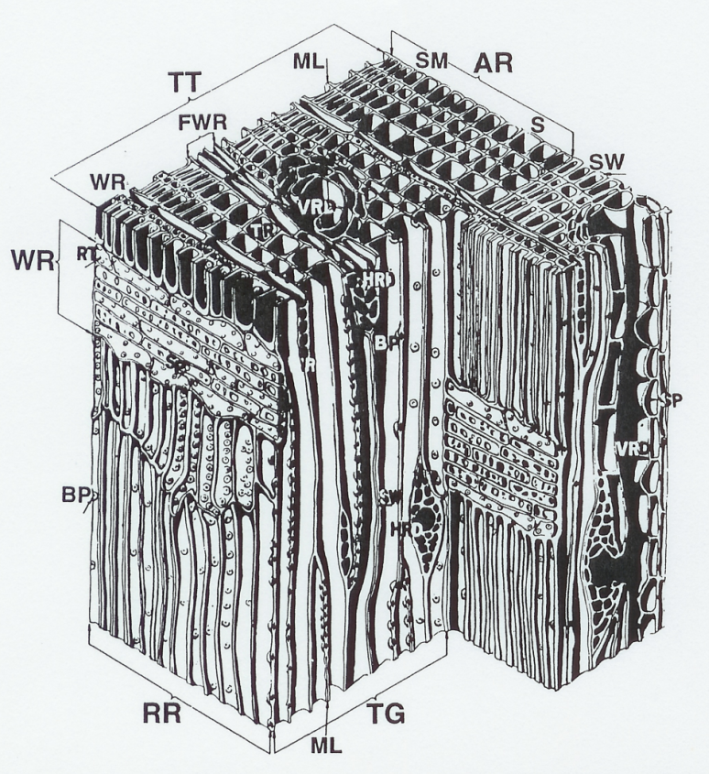
Wood Structure and Properties
Hardwood
Softwood

Slide 2
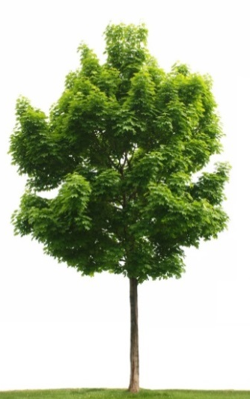
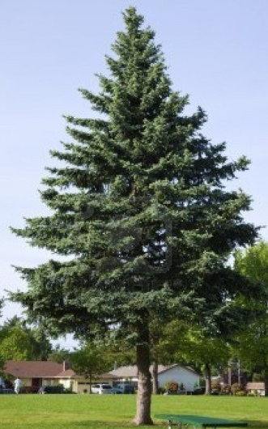
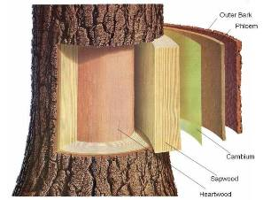
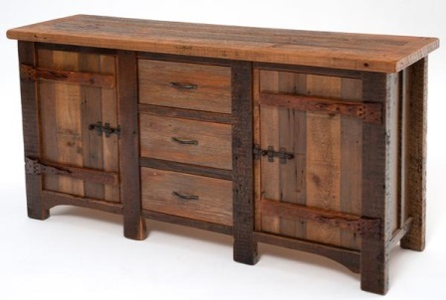
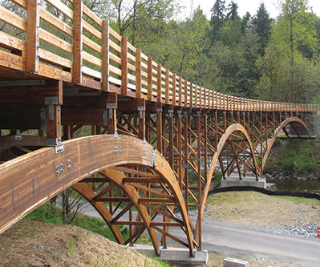
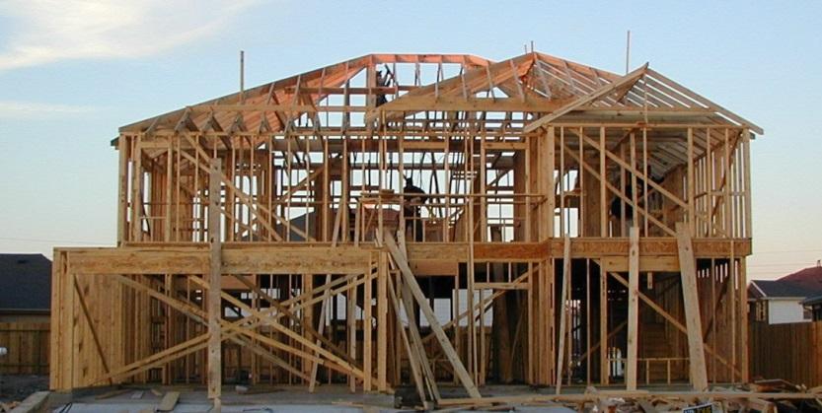
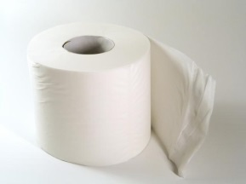
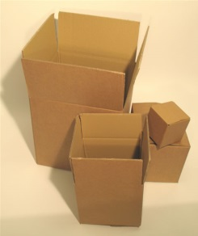
Functions of wood
Outer bark
Inner bark
Cambium
Sapwood
Heartwood

Slide 3
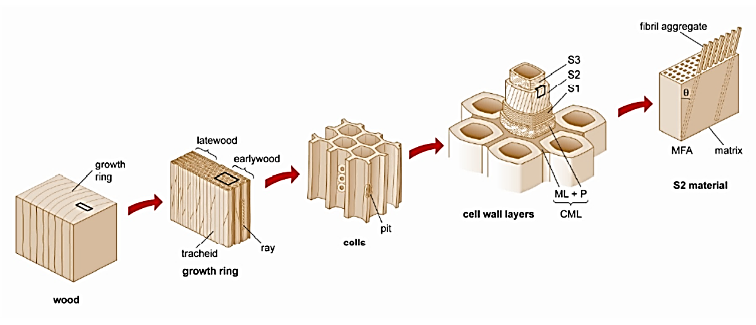
Levels of scale in wood structure
Molecular
Ultrastructural
Microscopic
Macroscopic

Slide 4
Biodegradability
Conditions necessary for fungal decay of wood.
Oxygen
Water
Temperature range
Nutrition source

Slide 5
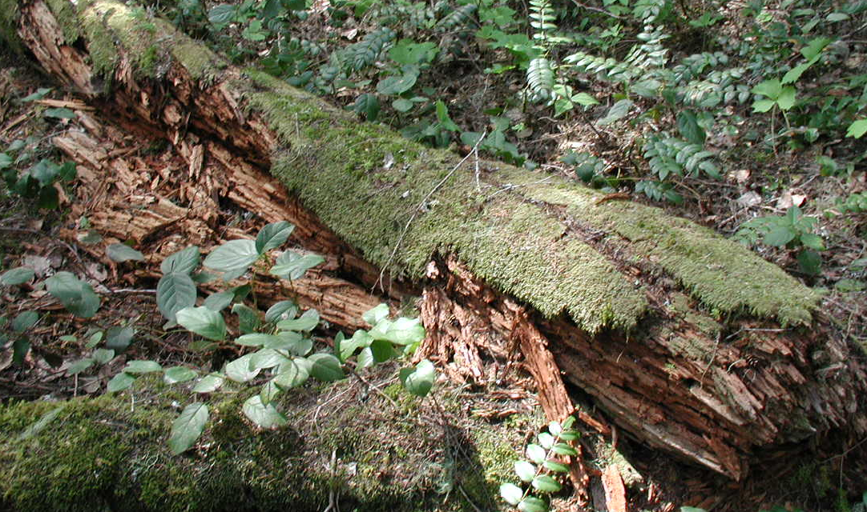
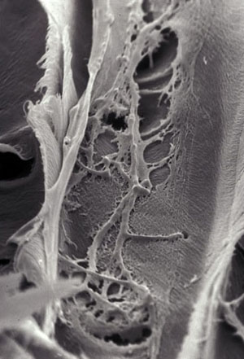
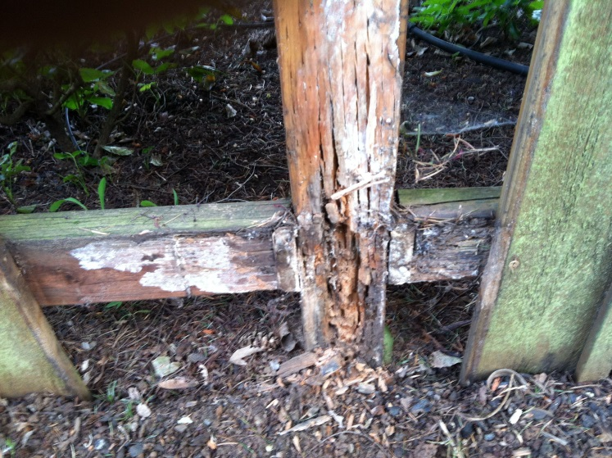
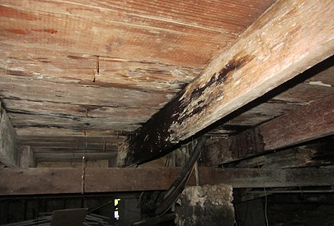
Fungal hyphae

Slide 6
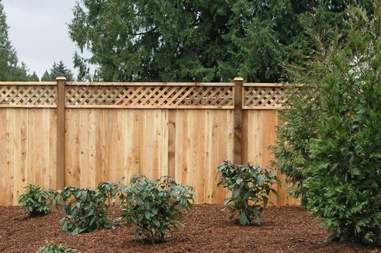
Fence post (preservative treated wood)
Fence panel (Western red cedar)
Oxygen
Water
Temperature range
Nutrition source

Slide 7
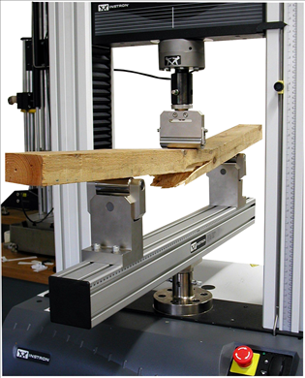
Variability in wood products
Solid wood
frequency
strength

Slide 8
Variability in wood products
mean
lower 5th percentile
Solid wood
frequency
÷ safety factors
allowable design stress
strength

Slide 9
Variability in wood products
mean
mean
lower 5th percentile
÷ safety factors
Solid wood
lower 5th percentile
frequency
÷ safety factors
Wood composite
allowable design stress
strength
allowable design stress

Slide 10
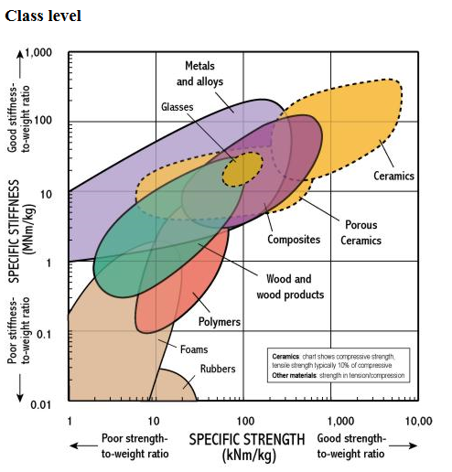
Specific strength / Specific stiffness

Slide 11
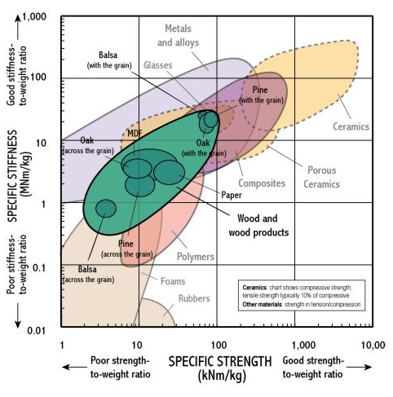
Specific strength / Specific stiffness

Slide 12
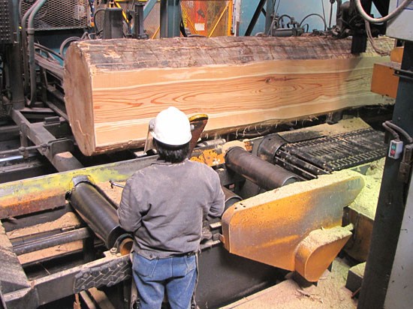
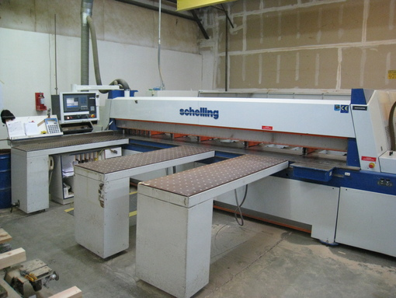
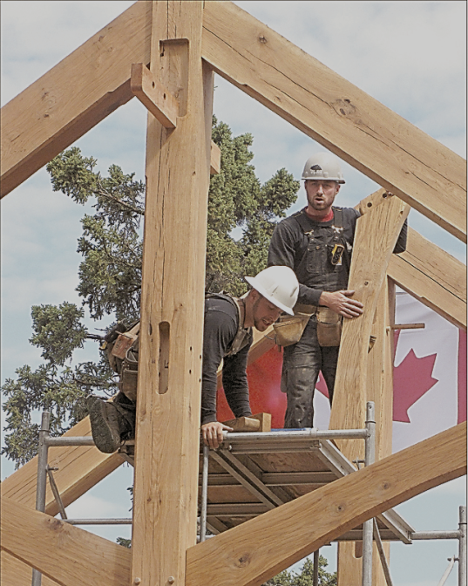
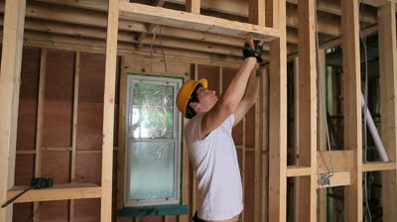
Workability

Slide 13
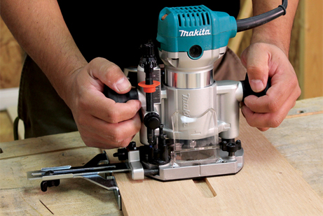
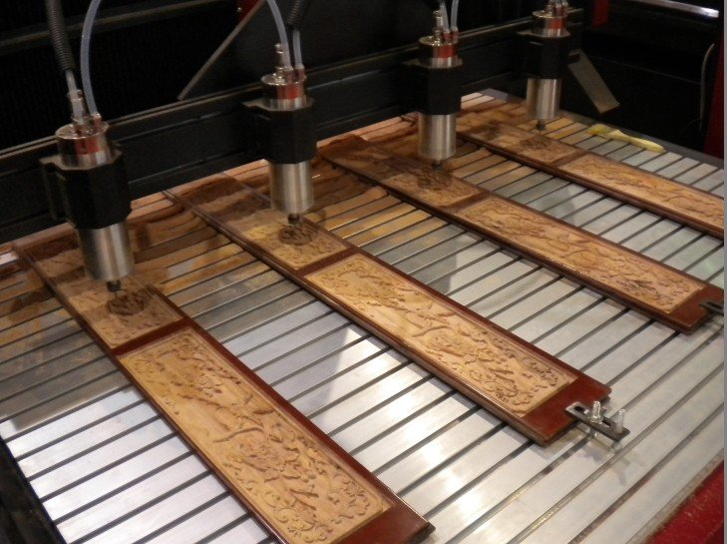
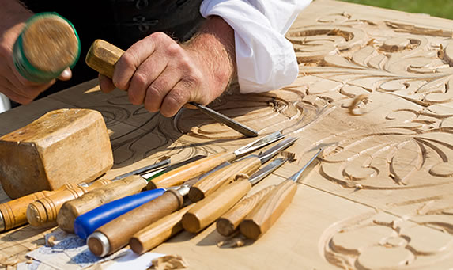
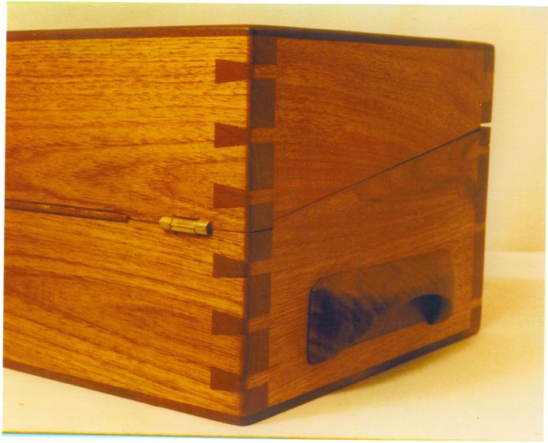
Workability

Slide 14
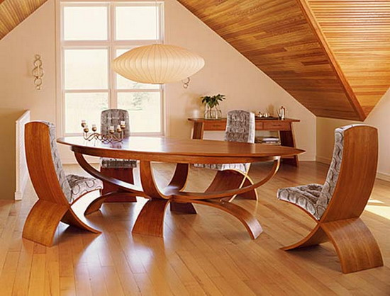
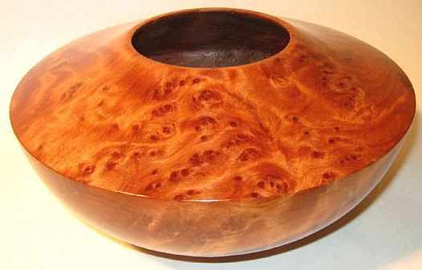
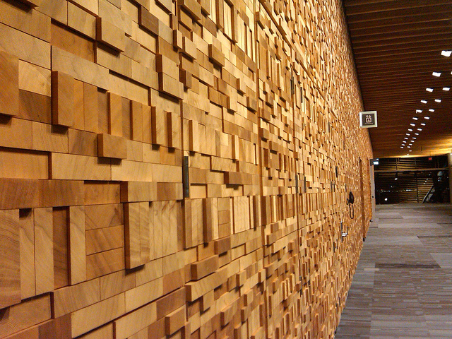
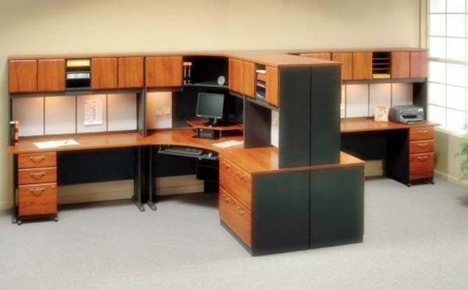
Aesthetics / Psychological appeal

Slide 15
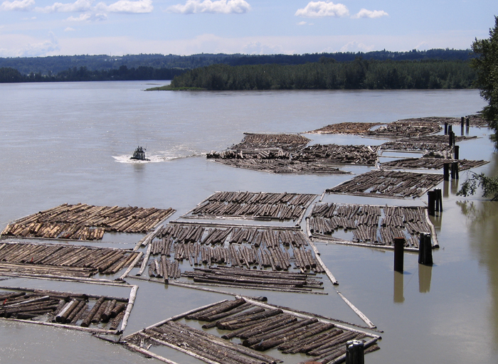
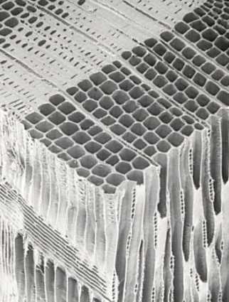
Bouyancy
Cell wall 1500 kg/m³
Air 0 kg/m³
Water 1000 kg/m³

Slide 16
1.3
1.2
1.1
1.0
0.9
0.8
0.7
0.6
0.5
0.4
0.3
0.2
0.1
0.0
Density of wood species (g/cm³)
Lignumvitae
Rosewood
Padauk Hickory Oak Teak Maple Walnut
Cherry
Basswood
Cottonwood
Balsa
Southern yellow pine
Douglas-fir
Hemlock
Lodgepole pine
Spruce
Western red cedar
Softwoods
Hardwoods
Domestic species
Exotic species

Slide 17
Increasing moisture content Increasing density

Slide 18
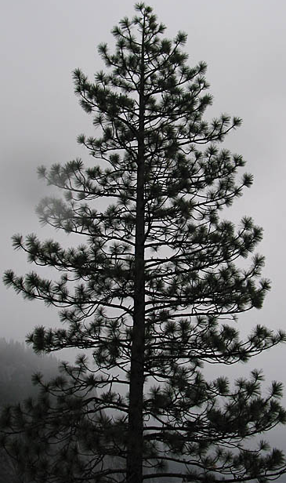
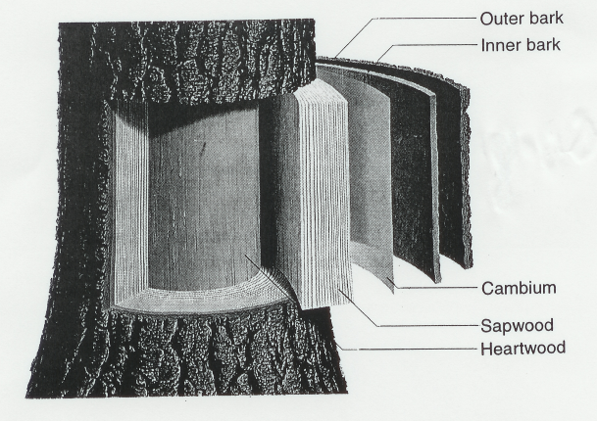
Anisotropy
(St. Regis Paper Co.)
(Indospectrum.com)
(Côté)

Slide 19
Anisotropy
Parallel to grain
Perpendicular to grain

Slide 20
Anisotropy – perpendicular to grain
Radial
Tangential

Slide 21
Anisotropy – varies by property
Longitudinal
Radial
Relative strengths
Longitudinal 5.0 Tangential 1.1
Radial 1.0
Tangential
Relative permeability
Longitudinal 100 Tangential 1
Radial 1

Slide 22
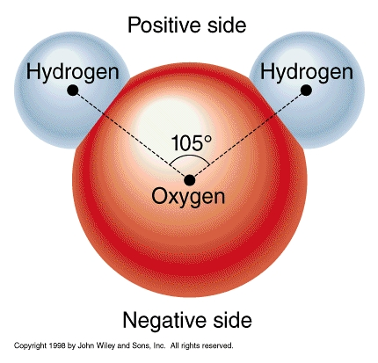
Hygroscopicity
Hydrogen
Bond
δ+
H
δ−
O
δ+
H
H
δ−
δ+
O
H
Water
δ+

Slide 23
Hygroscopicity
Hydrogen
Bond
δ+
H
Wood
O
δ−
δ+
H
δ−
O
H
δ+

Slide 24
Water in cell wall
H
H
H
O
H
H
O
O
O
O
O
H
H
H
H
H
H
H
O
O
O
O
H
O
H
O
H
H
O
H
H
H
H
H
O
O
O
O
H
O
H
H

Slide 25
Water in wood
Bound water
Free water
Cell wall
Cell lumen
Oven dry > Fibre saturation point 0% m.c. 0 – 30% m.c. > 30% m.c.

Slide 26
Water removal from wood
“Green”
Fibre Saturation Point
Oven-Dry

Slide 27
Effect of moisture content on wood properties
Fibre Saturation Point

Slide 28
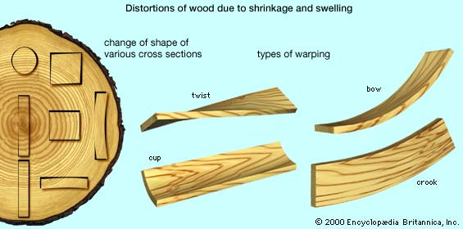
Warping
Wood can become bent or twisted out of shape as it dries below fibre saturation point.
Natural shrinkage in combination with other factors such as anisotropy, spiral grain, and differential longitudinal shrinkage.

Slide 29
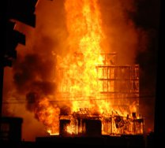
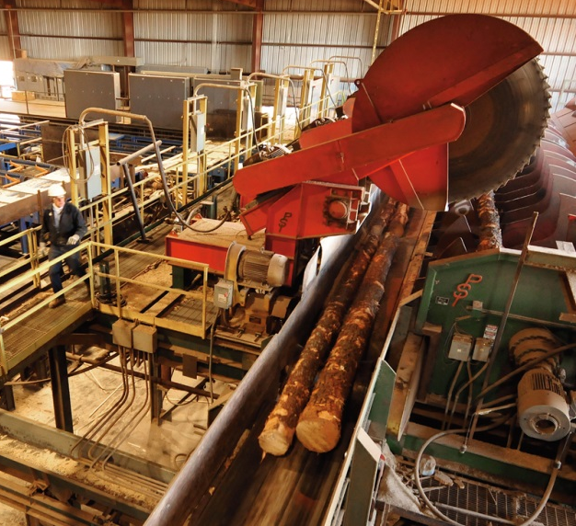
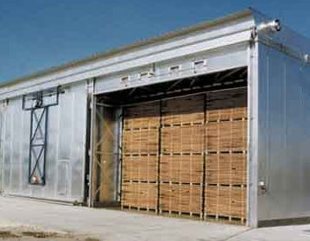
Combustibility

Slide 30
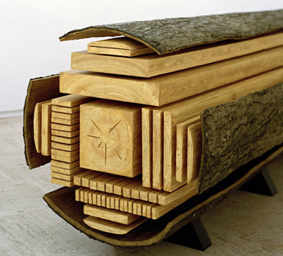
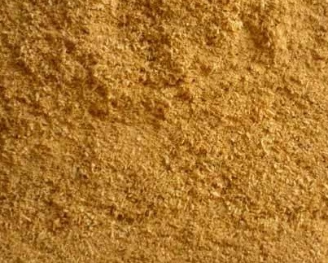
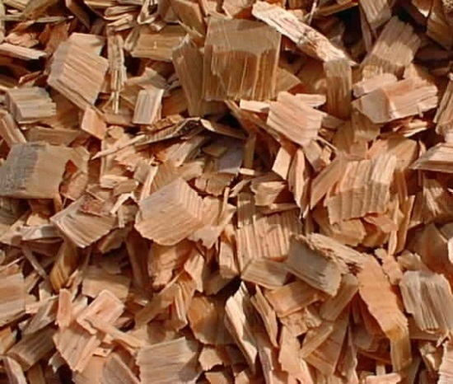
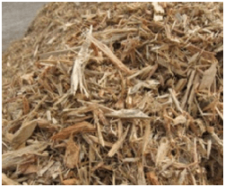
Sawmill residues
Sawdust Chips Hog fuel

Slide 31
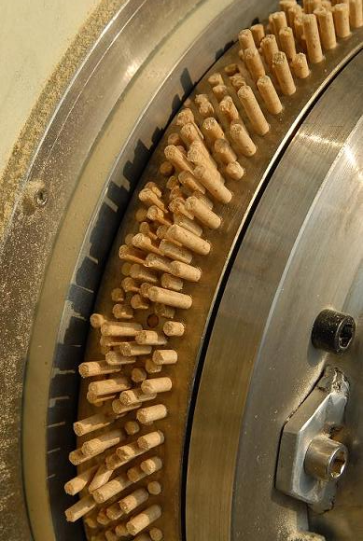
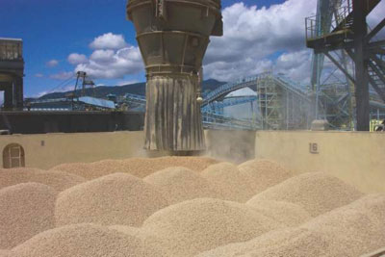
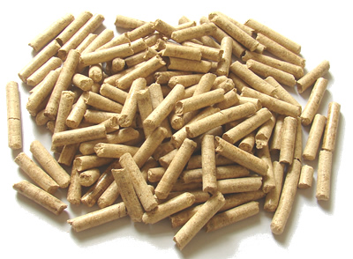
Wood pellets

Slide 32
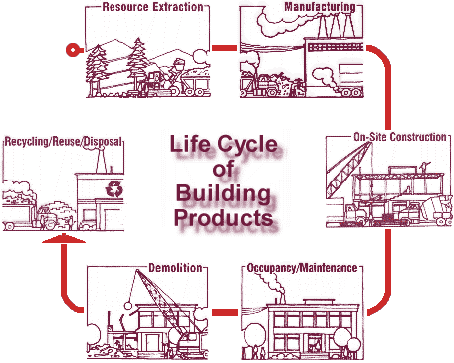
Comparative Environmental Impact Assessment Life Cycle Analysis
Canadian Wood Council

Slide 33
Comparative Environmental Impact Assessment
Canadian Wood Council

