Slide 1
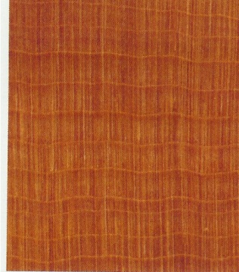
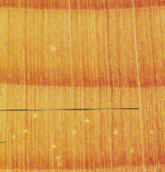
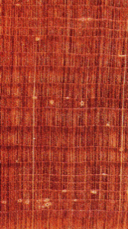
Wood Identification Softwoods
White pine
Lodgepole pine
Southern pine
Yellow cedar
Redwood
Bald cypress
Spruce
Western red cedar
True fir
Hemlock
Douglas-fir
Larch
Tamarak
Juniper

